Slide 1
Capital Bikeshare project
Hannah Barker, tom dirienzo
Alpesh patel, Pat wolfe

Slide 2
outline
Objectives
Data Sources
Analysis
Locations and Distances
Impacts on Ridership
Bikeshare API Data Discovery
Future Considerations
Conclusions

Slide 3
Objectives
Examine patterns that affect ridership for Capital Bikeshare riders
What are the most popular routes for casual riders and members?
How does the number of riders change over one day? One year?
Do temperature and precipitation affect ridership?
Can the status of stations be visualized to understand what stations are overburdened?
Notes:
* [ ] Summarize where and how you found the data you used to answer these questions
* [ ] Describe the data exploration and cleanup process (accompanied by your Jupyter Notebook)
* [ ] Describe the analysis process (accompanied by your Jupyter Notebook)
* [ ] Summarize your conclusions. This should include a numerical summary (i.e., what data did your analysis yield), as well as visualizations of that summary (plots of the final analysis data)

Slide 4
Data sources
Capital Bikeshare Ride Data
Start and stop locations
Ride duration
Member type – Casual vs. member
Open Data DC - Capital Bikeshare API
Station Information
Station Status
Geographical coordinates for Capital Bikeshare locations
Open Weather Map – Historical Data for Washington, D.C. in 2018
Temperature
Precipitation

Slide 5
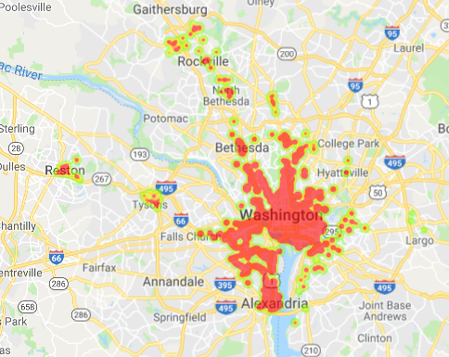
Locations and distances
Located in bike-able urban areas in the DC metro area including Virginia: (Reston, Tyson’s Corner, Alexandria) and Maryland (Bethesda, Rockville)
Locations
Latitudes and Longitudes from Open Data DC
Google API location errors with three states
Distances
Calculated using the haversine formula
Great-circle distance between two points on a sphere given latitudes and longitudes
Google Distance Matrix API fee based

Slide 6
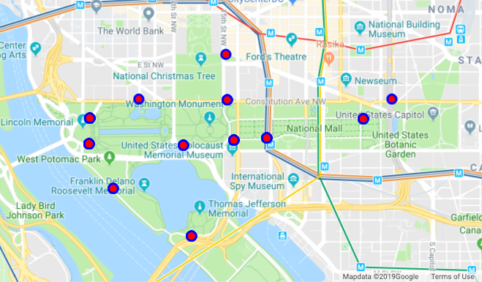
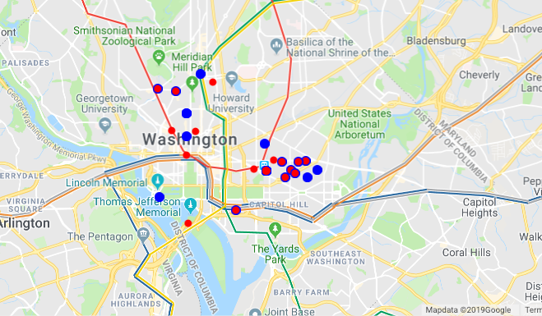
Ridership by member type
Casual riders
~750,000 trips in 2018
~48,000 unique routes
Averaged 1.05 miles between stops
Median 0.91 miles between stops
Most frequent routes centered around the National Mall
Member riders
~2,800,000 trips in 2018
~67,500 unique routes
Averaged 1.09 miles between stops
Median 1.74 miles between stops
Most frequent routes centered around areas without metro access
H Street NE, Logan Circle, Adams Morgan
25 most frequent start (blue) and stop (red) locations

Slide 7
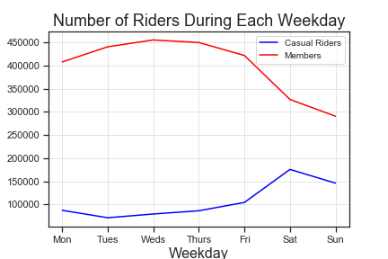
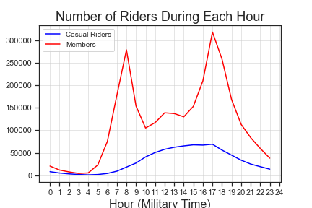
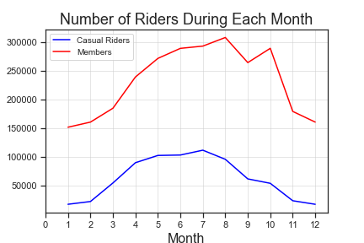
Ridership over time
Member riders
Usage drops during weekends
Usage peaks during rush hour 8:00am and 5:00pm
Casual riders
Usage peaks during weekends
Usage roughly steady between 10:00am and 6:00pm
Both groups prefer summer months

Slide 8
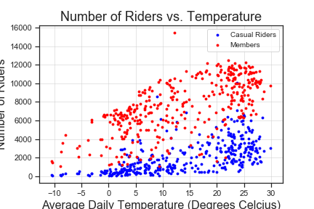
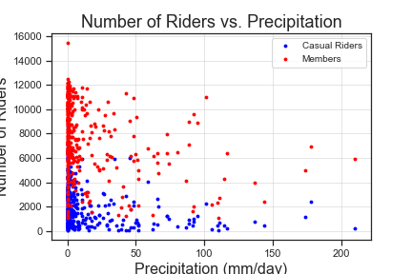
Weather impacts on Ridership
Ridership loosely correlated with temperature and precipitation

Slide 9
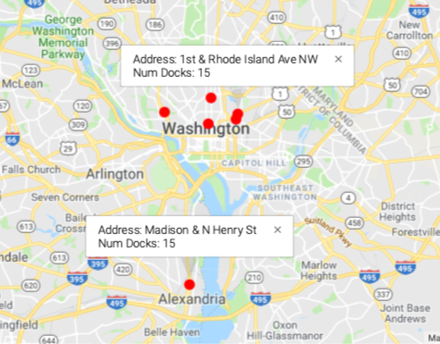
Bikeshare API data discovery
In addition to historical data, D.C. provides Real Time Bikeshare data through an API
This data provides a wealth of possibilities
What is the current status of any station?
Which bike stations most often run out?
To analyze this data requires capturing and storing the streaming data to build out a data set
This was done by having a script run in Jupyter for an extended period of time
To truly harness this data’s potential would require a better databasing method and dedicated virtual machine
Notes:
* **Data Analysis**
* Discuss the steps you took to analyze the data and answer each question you asked in your proposal
* Present and discuss interesting figures developed during analysis, ideally with the help of Jupyter Notebook
* **Discussion**
* Discuss your findings. Did you find what you expected to find? If not, why not? What inferences or general conclusions can you draw from your analysis?
* **Post Mortem**
* Discuss any difficulties that arose, and how you dealt with them
* Discuss any additional questions that came up, but which you didn't have time to answer: What would you research next, if you had one more week?
------------------------------
* [ ] Summarize where and how you found the data you used to answer these questions
* [ ] Describe the data exploration and cleanup process (accompanied by your Jupyter Notebook)
* [ ] Describe the analysis process (accompanied by your Jupyter Notebook)
* [ ] Summarize your conclusions. This should include a numerical summary (i.e., what data did your analysis yield), as well as visualizations of that summary (plots of the final analysis data)

Slide 10
Future considerations
Where is the best locations for increased docks/stations?
Can machine learning be applied to the streaming data to provide better prediction of demand?
How does proximity to a Metro station impact Capital Bikeshare ridership?
How did the introduction of electric scooters impact Capital Bikeshare ridership?
How do patterns in Uber and Lyft ridership compare with Capital Bikeshare ridership?

Slide 11
Conclusions
Bikeshare and Public Transportation Data in D.C. is a very rich dataset and generally very clean making it great for analysis
Our analysis supported our hypotheses:
Tourists use Capital Bikeshare to site see. Members use Capital Bikeshare as a form of commuting for areas without metro access
There is a significant increase in ridership for Capital Bikeshare members near 8:00 AM and 5:00 PM, while the number of casual Capital Bikeshare users gradually increases over the course of the day
There is an increase in ridership for Capital Bikeshare members and casual riders during the warmer months
There is a correlation between Capital Bikeshare ridership and temperature, and ridership and precipitation
Demand can be derived from the real-time Bikeshare data to inform future support

Slide 12

Q & A

